Slide 1
Advanced Programming Semester Project
Team Members:
Ahmad Jarrar Khan [249423]
Haleema Ramzan [271712]
Hamiz Ali [250261]
Sharique Pervaiz [264098]

Slide 2







Development Environment
VS Code Sublime Text Sublime Merge GitHub
Python C++ GNU GCC

Slide 3
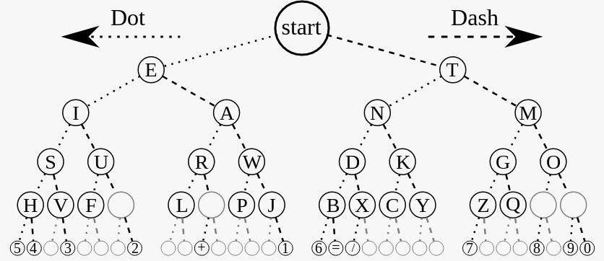
Problem 1
Approaches
Naïve
Two arrays are stored for morse code and ASCII characters.
Input searched through array linearly and corresponding element in other array fetched for result.
Optimized
ASCII code of character is used to calculate the index for corresponding morse code character.
Binary tree is stored and traversed for each element to get corresponding character.

Slide 4
ii. Optimizations
Optimized naïve algorithm worse case for string to morse code O(36n) improved to O(1n), and for morse to string O(36n) improved to O(5n). In logarithmic terms, complexity still remains O(n), but in practice it makes a noticeable difference.
Compiler optimization: loops unrolled

Slide 5
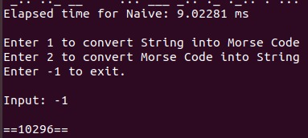
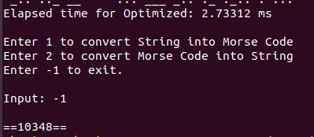
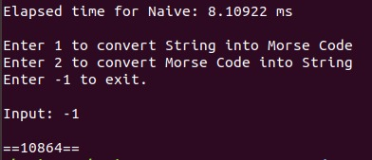
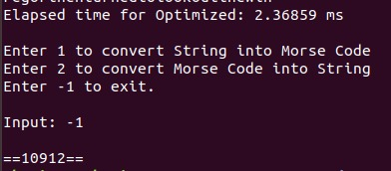
ii. Measurements
Time Comparison
Naïve Optimized
String to Code String to Code
Code to String Code to String

Slide 6
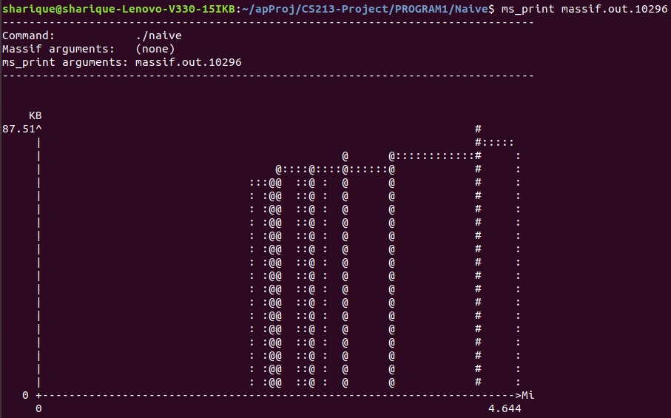
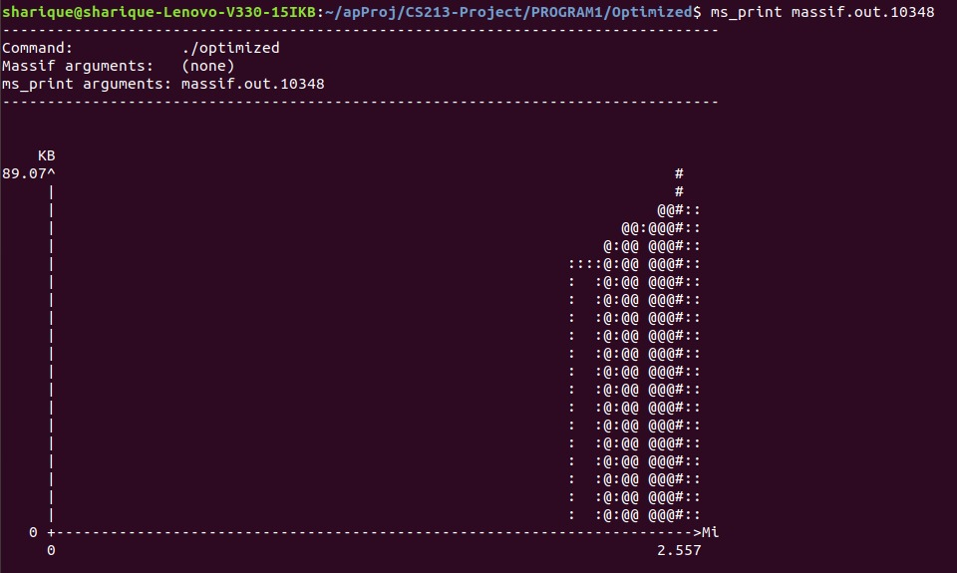
Memory Comparison
Naïve Optimized
String to Code String to Code

Slide 7
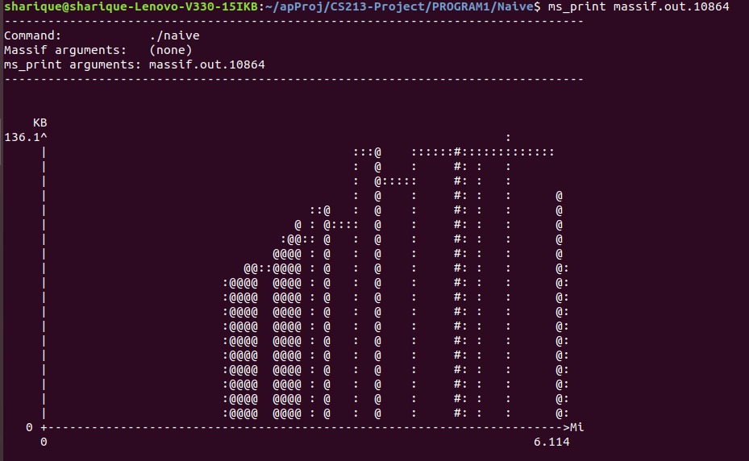
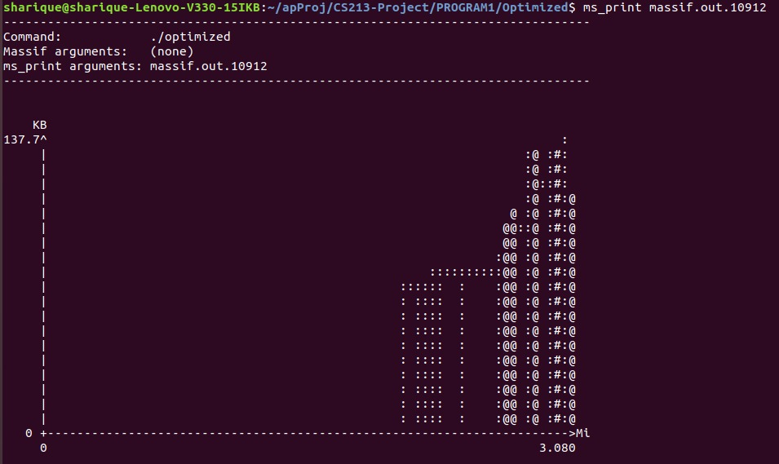
Memory Comparison
Naïve Optimized
Code to String Code to String

Slide 8
Problem 2
Approaches
Naïve
Given two strings A and B, a brute force approach checks for every possible subsequence of A and matches to string B if it also a subsequence in B.
Optimized
The optimal substructure property is used to solve the problem using Dynamic Programming.
For the given strings A and B, we create a matrix of (n+1, m+1) to track the longest common subsequence.

Slide 9
Dynamic Programming Algorithm
Fill first row and column with 0s. If the current row and col chars match, fill with 1 + left diagonal entry and point to it. Otherwise, take the max (col, row) and point to it. If equal, point to either one.
 |  | A | B | C | D
 | 0 | 0 | 0 | 0 | 0
B | 0 | 0 | 1 | 1 | 1
D | 0
H | 0
Repeat the process for the entire table and fill with pointers. The value in the last row and column is the length of longest common subsequence.
 |  | A | B | C | D
 | 0 | 0 | 0 | 0 | 0
B | 0 | 0 | 1 | 1 | 1
D | 0 | 0 | 1 | 1 | 2
H | 0 | 0 | 1 | 1 | 2
To find longest common subsequence, follow the direction of arrows from last entry in table up to the end of table.
 |  | A | B | C | D
 | 0 | 0 | 0 | 0 | 0
B | 0 | 0 | 1 | 1 | 1
D | 0 | 0 | 1 | 1 | 2
H | 0 | 0 | 1 | 1 | 2
Select the entries with the diagonal arrows, these correspond to the longest common substring characters. In this example, the green boxes (BD).
 |  | A | B | C | D
 | 0 | 0 | 0 | 0 | 0
B | 0 | 0 | 1 | 1 | 1
D | 0 | 0 | 1 | 1 | 2
H | 0 | 0 | 1 | 1 | 2

Slide 10
ii. Optimizations
There are 2^{m} subsequences to be checked, and matched with length of n, so naïve algorithm has a complexity of O(n.2^{m}). This is improved by using enhanced dynamic programming algorithm, which tracks the longest common subsequence using an (n+1, m+1) matrix, effectively reducing the time complexity to O(nm).
Compiler optimization.

Slide 11
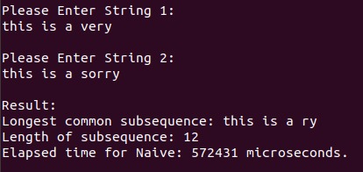
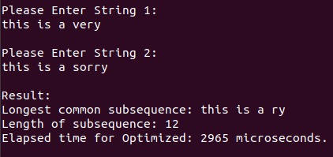
ii. Measurements
Time Comparison
Naïve - Brute Force: Optimized – Dynamic Programming:

Slide 12
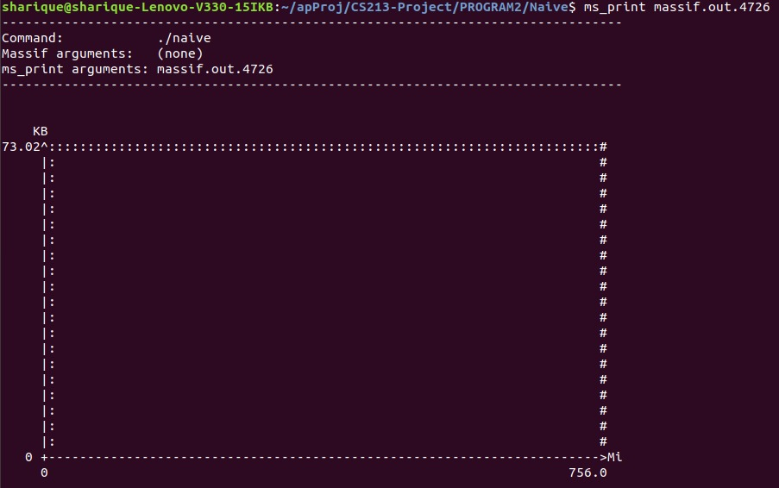
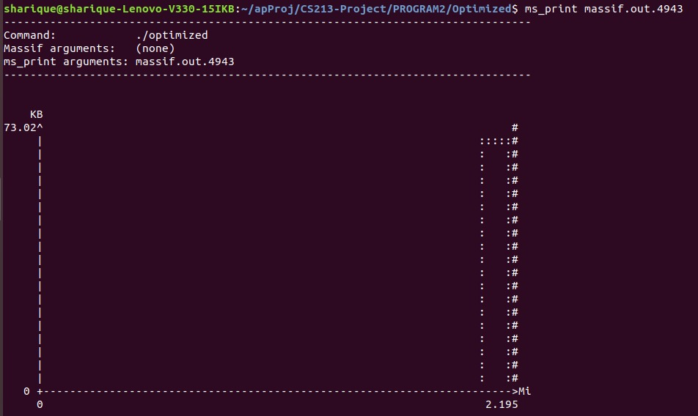
Memory Comparison
Naïve - Brute Force: Optimized – Dynamic Programming:

Slide 13
Problem 3
Approaches
Naïve
Naïve longest common substring algorithm applied in problem 2 to get the common subsequence of the strings.
Two loops applied to get the sequence of characters inserted and deleted in O(n).
Dynamic
Dynamic Programming algorithm of problem 2 for longest common subsequence reused to get the common subsequence of the strings, and the result.
Simple comparisons used to find insertions and deletions.

Slide 14
ii. Optimizations
Complexity mainly dependent on finding longest common subsequence.
Complexity of the longest common subsequence algorithm was changed from O(n.2^{m}) to O(nm).
Compiler optimization.
Other minor optimizations include
String comparison loops are using registers as iterators
Pre-increment used instead of Post-increment

Slide 15
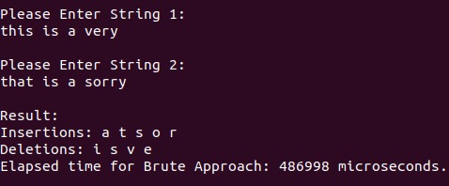
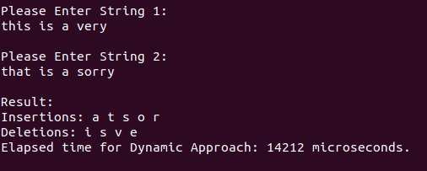
ii. Measurements
Time Comparison
Naïve Dynamic

Slide 16
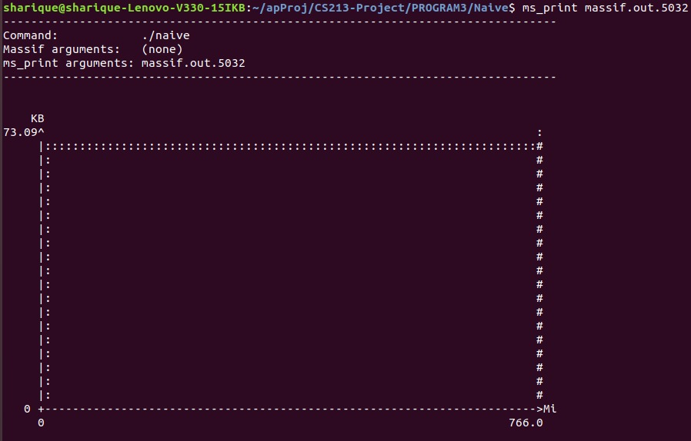
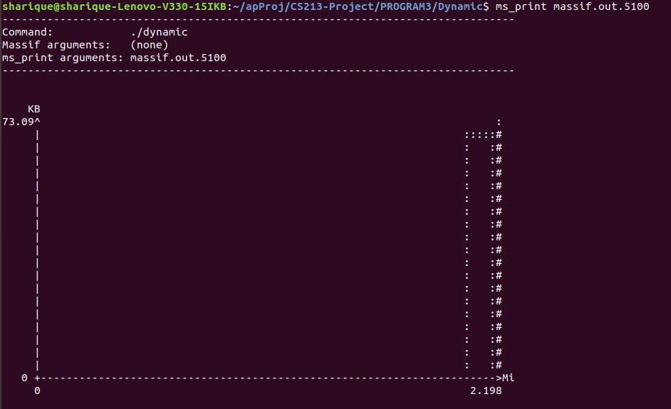
Memory Comparison
Naïve - Brute Force: Optimized – Dynamic Programming:

Slide 17
Problem 4
Approaches
Loops 𝑂(𝑛^3 )
Three loops to iterate over the elements of two matrices, finding the dot product and accumulating the result in third matrix.
Variations in this method include basic loops, cached loops, and multithreaded functions.
Strassen’s Algorithm 𝑂(𝑛^2.8 )
The algorithm follows divide and conquer approach.
It saves one matrix multiplication (7 instead of 8) but the overhead of recursion and preprocessing (padding and finding constant values) takes up more time.

Slide 18
Standard loops (i, j, k)
Key:
Blue : i
Yellow : j
Green : k

Slide 19
Standard loops (i, j, k)
Key:
Blue : i
Yellow : j
Green : k

Slide 20
Cache Optimized loops (i, k, j)
Key:
Blue : i
Yellow : j
Green : k

Slide 21
Cache Optimized loops (i, k, j)
Key:
Blue : i
Yellow : j
Green : k

Slide 22
ii. Optimizations
Changing the order of loops made the function more cache friendly, improving performance significantly.
Multiplication was performed in parallel for each row of first matrix, which resulted in almost 6x improvement on 4 cores with HT.
Performance of Standard Library function (boost::ublas::prod) was beaten.
Compiler Optimizations SIMD instructions, Loops unrolled etc.

Slide 23
iii. Performance Chart

Slide 24


Problem 5
Tools & Libraries
Python 3.8 Pygame Pygame_Menu
Optimizations
There was no need to explicitly optimize the game as the Frame rate is capped to 60 FPS.

Slide 25
iii. Approach – Game Design
Main Screen is divided into several subsections (surfaces) which can be independently refreshed.
Graphics are displayed in layers.
Game has two boards which contain all the information of the two players
Ships are overlayed on top of these boards.
Finally, animations are overlayed.
Game runs in a simple loop
Player turn or AI turn
Update screen

Slide 26

iv. Artificial Intelligence
AI keeps track of the following
coordinates missed
coordinates hit
number of active ships
coordinates of sunken ships
smallest active ship in the board
anchor hit

Slide 27
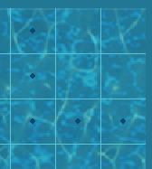
Random Mode
Initial mode where coordinates are randomly generated. The generated coordinate is discarded if smallest ship is not possible to be placed there.
If ship of length 2 is destroyed, AI will never attack these coordinates.
When a hit is recorded, that coordinate is set as the anchor hit and attack mode is switched to destroyer mode.

Slide 28
Attack Mode
The AI attacks the neighboring coordinates of anchor point to get the direction to keep attacking next
After the second hit, a direction is recorded and next attacks are launched in that direction (horizontal or vertical) until a miss is recorded or a ship is destroyed.
After a ship is destroyed, the values are updated and the board is checked for partially destroyed ships. If found, anchor is changed and the damaged ships are attacked.
When there are no partially destroyed ships left, the attack mode is switched to random.

Slide 29


